Slide 1

Research Methodology
Data Collection
Dr. Arti Arya
Department of Computer Science and Engineering

Slide 2


Research Methodology
Data Collection
Chapter 6
Dr. Arti Arya
Department of Computer Science and Engineering

Slide 3
Research Methodology
Disclaimer
These slides are prepared from the prescribed text book and other reliable resources from the Internet.
The images are imported from various sites and videos are imported from youtube.com

Slide 4

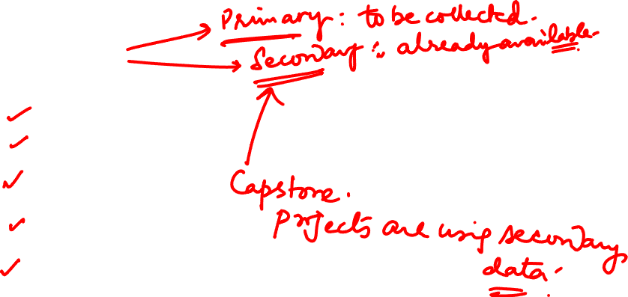
Research Methodology
Data Collection
Primary data Collection :
Fresh
First Time
Original in Character
Secondary data Collection :
Already collected by some one
Already passed through statistical process

Slide 5
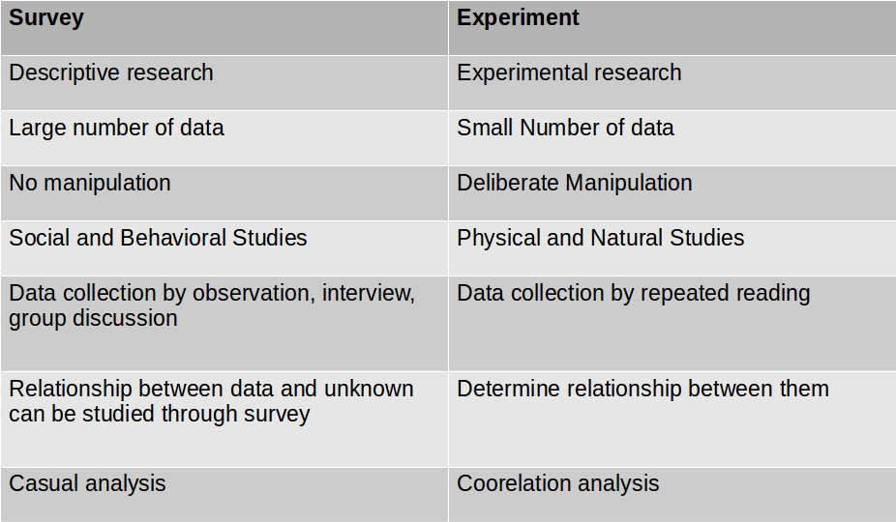
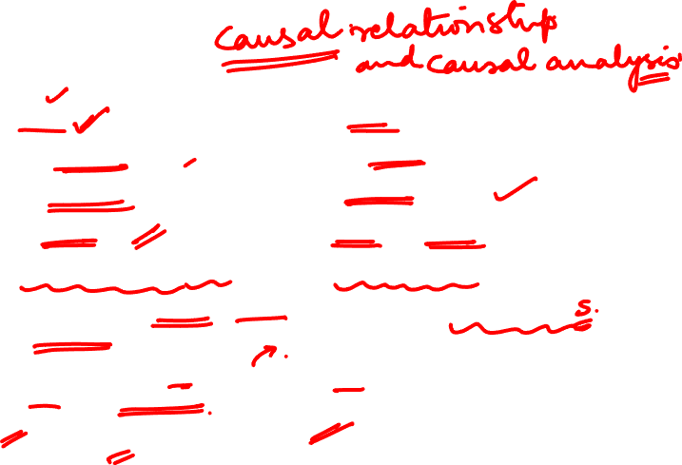
Research Methodology
Survey vs Experiment

Slide 6



Research Methodology
Collection of Primary Data
Observation Method
Interview Method
Personal Interview
Telephonic Interview
Questionnaires
Schedules
Other methods

Slide 7
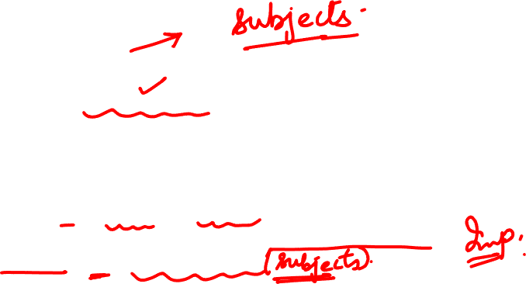
Research Methodology
Observation Method
Related to Behavioural Sciences
Non scientific method – To observe things around us
Scientific tool -
systematically planned and recorded,
subjected to checks and
Controls on validity and reliability.
Information is sought by way of investigators own direct observation w/o asking respondents

Slide 8

Research Methodology
Observation Method
Advantages :
Subjective bias is eliminated ; if observation done accurately.
Relates to current happenings
Independent of respondents
Limitations:
Expensive method
Limited information is provided.
Unforeseen factors interfere
People may not be accessible

Slide 9
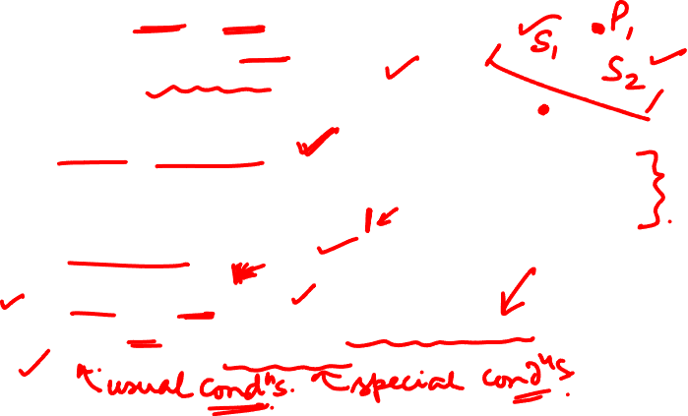
Research Methodology
Observation Method
While using this method researcher should keep following in mind
What should be observed?
How should observation be recorded?
How can accuracy be ensured?
Few Terminologies
Structured Observation
Units to be observed, style of recording the obsevation, standardised conditions, pertinent data selection
Appropriate for Descriptive studies
Unstructured Observation
Exploratory studies
Participant Observation
Non Participant Observation (Disguised Observation)
Controlled and Non Controlled Observation.

Slide 10



Research Methodology
Interview Method
Presentation of Oral Verbal Stimuli and reply in oral verbal responses.
2 types
Personal Interview
Telephonic Interview

Slide 11

Research Methodology
Personal Interview Method
Requires person as interviewer asking questions generally F2F contact to other person.
Direct Personal Interview : Interviewer must collect info personally from sources concerned.
He has to be on the spot and has to meet people from whom data has to be collected.
Indirect Personal Interview : Interviewer cross examines other person who are supposed to have knowledge about the problem under investigation.

Slide 12

Research Methodology
Personal Interview Method
Structured Interview:
Method of collecting information through personal interview usually done is structured way.
Predetermined set of questions.
Rigid procedure asking the questions in form and order prescribed.
Unstructured Interview
Flexibility approach of questioning.
Do not follow predetermined questions and standards
Interviewer allowed much greater freedom to ask, ask supplementary questions, omit certain questions.
He may change sequence of questions

Slide 13

Research Methodology
Personal Interview Method
Focused Interview:
The attention of the interviewer is focussed on the experience of respondent.
Clinical Interview:
It is based on the respondent’s course of life experiences.
Non Directive Interview:
encourage respondent to talk more.

Slide 14

Research Methodology
Merits of Interview Method
More information in greater depth.
Greater flexibility to restructure questions.
Observation – applied to recording verbal answers
Personal information can be easily obtained.
Low non response.
Interviewer can easily control which person will answer the questions.
Language of the interview can be adopted easily, misinterpretations concerning questions can be avoided.
There are some more merits.

Slide 15
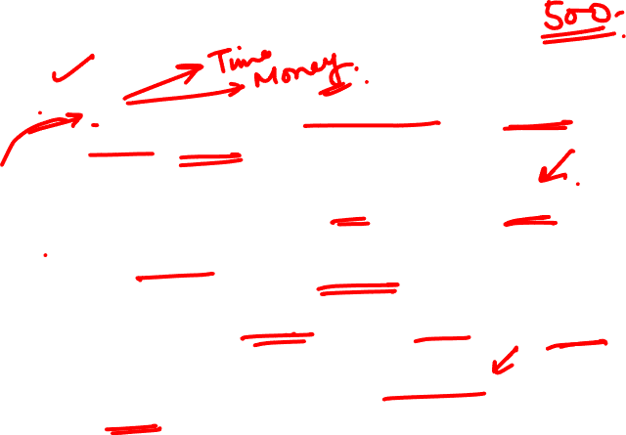
Research Methodology
Demerits of Interview Method
Expensive – when large geographical locations are taken as samples.
Few respondents may not be easily approachable.
Time consuming when sample is large.
Presence of interviewer may stimulate respondents.
Selecting, training and supervising field staff is complex.
There are many more demerits.

Slide 16

Research Methodology
PREREQUISITES & BASIC TENETS OF INTERVIEW METHOD
Interviewer should be carefully selected, trained and briefed.
They should be honest, sincere and hardworking, must possess technical competence and necessary practical experience.
Field checks should be made – to ensure interviewer is neither cheating nor deviating from instructions given.

Slide 17

Research Methodology
Telephonic Interview
Method of collecting information contacting respondents over telephone.
Not widely used, but plays important role in industry surveys.
Merits:
More flexible
Faster than other modes
Cheaper than personal interview
Replies can be recorded.
Easy to call back
No field staff requirement
Higher rate of response than mailing method
Wider range of respondents

Slide 18
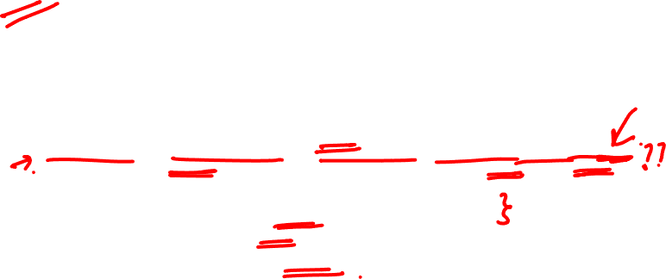
Research Methodology
Demerits of Telephonic Interview
Demerits:
Little time given to respondents to answer
Extensive geographic coverage may be restricted because of cost.
Questions to be short, answers to the point
Survey is restricted to respondents with telephones
Not suitable for comprehensive answers.
Probability of bias of interviewer is relatively more

Slide 19
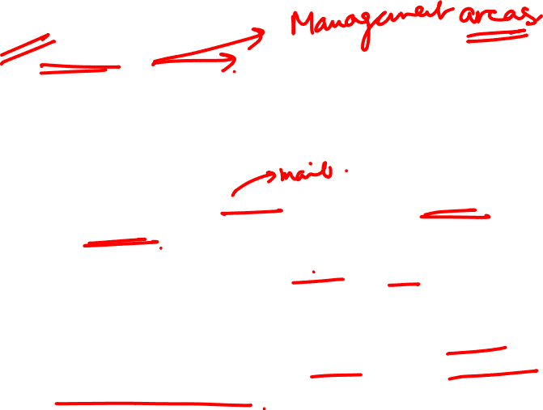
Research Methodology
Questionnaire
Big enquiries – economic and business surveys.
Being adopted – private individuals, research workers, private and public organizations, governments.
Questions are sent (by post) to persons concerned and required to answer and return.
Consists of number of questions printed or typed in definite order on a form/s.
Questionnaire is mailed to respondent/s and who is expected to read and understand the questions and write down their reply in space meant for the purpose.

Slide 20

Research Methodology
Questionnaire
Merits
Low cost even over large geographic area.
Free from bias of interviewer
Respondents have adequate time to respond
Respondents who are not easily approachable can also be reached conveniently.
Large samples can be made use of, results can be reliable
Demerits
Low rate of return
Used when respondents are educated and cooperating.
Control over questionnaire may be lost when sent.
Inbuilt inflexibility – amending approach once dispatched.
Difficult to know whether willing respondents are truly representative.
Slowest of all methods.
Incomplete/ambiguous answers – hard to interpret.

Slide 21
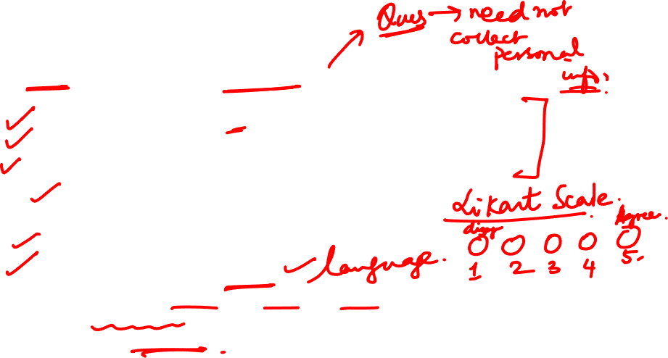
Research Methodology
Questionnaire
Pilot Study may be required to test the questionnaire – rehearsal of main survey:
Weakness of questionnaire may be identified
Omission of questions
Modification (reordering/rewording/rephrasing) of questions may be required – wrong interpretation of question by respondent
Main aspects of questionnaire:
General form
Question sequence
Question formulation and wordings
Very clear in construction – simple, easily understood
Open ended questions
Multiple choice questions, True/False

Slide 22

Research Methodology
Questionnaire
Essentials of a good questionnaire:
Should be short and simple
Should proceed in a logical sequence
Personal and intimate questions should be left for the end.
Technical terms and vague expressions should be avoided.
Questions should be dichotomous or open-ended.
There should be some control questions to indicate the reliability of the respondent.
Should always have a provision for indicating uncertainty: like “ don’t know” etc.

Slide 23

Research Methodology
Schedules
The schedule is another data collection technique containing statements, questions, and blank spaces to fill up the answers given by the respondents to the enumerator or interviewer.
A schedule is a structure of a set of questions on a given topic which are asked by the interviewer or investigator personally. ... It contains direct questions as well as questions in tabular form. Schedule include open-ended questions and close-ended questions.
Schedules are filled by enumerators who are appointed for this purpose.

Slide 24

Research Methodology
Schedules
These enumerators go to respondents, ask listed questions and record the replies.
In few instances schedules may be handed over to respondents and enumerators may help them in recording answers.
Enumerators should explain objectives of investigation and remove difficulty giving appropriate clarifications.

Slide 25

Research Methodology
Schedules
Benefits:
It is a useful method in case the informants are illiterate.
The researcher can overcome the problem of non-response as the enumerators go personally to obtain the information.
It is very useful in extensive studies and
Can obtain more reliable data
Demerits
Very expensive
Enumerator selection
Enumerators to be trained extensively

Slide 26
Research Methodology
Questionnaire vs Schedules
Both questionnaires and schedules are popularly used methods of collecting data in research surveys.
There is much resemblance in the nature of these two methods. From a practical point of view, the two methods can be taken to be the same.
But from a technical point of view there is difference between the two.

Slide 27
Research Methodology
Questionnaire vs Schedules
# | Questionnaires | Schedules
1 | Filled out by the respondent. | Generally filled out by the research worker or the enumerator.
2 | Relatively cheap and economical; no field staff required. | Relatively more expensive; appointing enumerators and in imparting training to them; preparing schedules also has costs.
3 | Non-response is usually high; Bias due to non-response often remains indeterminate. | Generally Non-response very low; Since filled by enumerators who get answers to all questions; Danger of interviewer bias and cheating exists.
4 | Not always clear as to who replies, respondent or someone on his/her behalf. | Identity of respondent is known to enumerator.
5 | Personal contact is generally not possible. | Direct personal contact is established with respondents by enumerator.

Slide 28
Research Methodology
Questionnaire vs Schedules
# | Questionnaires | Schedules
7 | Can be used only when respondents are literate and cooperative. | Respondents may be illiterate.
8 | Wider and more representative distribution of sample | Difficulty in sending enumerators over a relatively wider area.
9 | Risk of collecting incomplete and wrong information is relatively more particularly when people are unable to understand questions properly. | Relatively more accurate; Generally complete and accurate as enumerators can remove the difficulties, if any.
10 | Success lies more on the quality of the questionnaire itself. | Depends upon the honesty and competence of enumerators.
11 | Physical appearance of questionnaire must be quite attractive. | Not Applicable.
12 | Observation method not possible. | Observation method can also be used.

Slide 29

Research Methodology
Secondary Data Collecction
Data already available – already collected and analysed by someone else.
Researcher should look into sources from where s/he can obtain.
2 forms of secondary data:
Published
Unpublished.

Slide 30
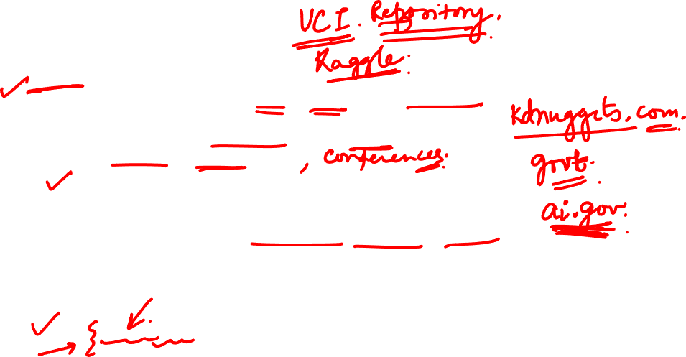
Research Methodology
Secondary Data Collecction
Published -
Publication in form of central, state and local government documents.
Publication of foreign govt and international bodies.
Technical and trade journals
Books, magazines and newspapers
Reports and publications of various business associations, industries, banks, stock exchanges, etc.
Reports prepared by universities, scholars, economists
public records and statistics, historical documents,
websites - Ex : RBI, NSE, etc.
Unpublished
diaries, letters, biographies, autobiographies, also made available with scholars and workers, trade associations, etc.

Slide 31
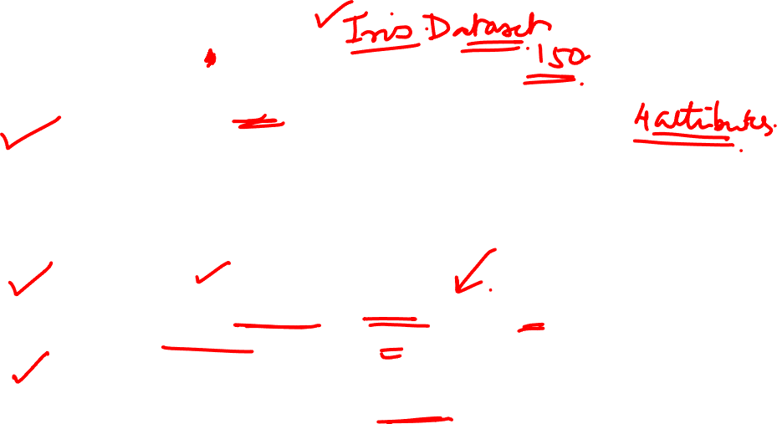
Research Methodology
Secondary Data Collecction
Caution before using secondary data to see following characteristics:
1. Reliability of data:
Who collected the data?
What were the sources of data?
Were they collected using proper methods?
At what time were they collected?
Was it achieved?
2. Suitability of data:
Data suitable for one enquiry may not be suitable for another. Hence if the data is found unsuitable it should not be used.
3. Adequacy of data:
If the level of accuracy is found to be inadequate, it should not be considered for research.

Slide 32
THANK YOU
Dr. Arti Arya
artiarya@pes.edu

Slide 33
Research Methodology
Data Collection-II
Dr. Arti Arya
Department of Computer Science and Engineering

Slide 34
Research Methodology
Data Collection
Chapter 6
Dr. Arti Arya
Department of Computer Science and Engineering

Slide 35
Research Methodology
Disclaimer
These slides are prepared from the prescribed text book and other reliable resources from the Internet.
The images are imported from various sites and videos are imported from youtube.com

Slide 36
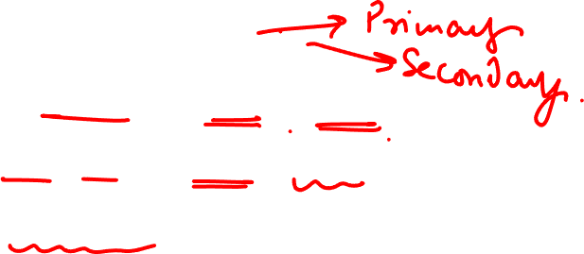
Research Methodology
Data Collection
Selection of Appropriate Method for Data Collection
1. Nature, scope and object of enquiry:
2. Availability of funds:
3. Time factor:
4. Precision required:

Slide 37


Research Methodology
Case Study Method (Data Collection)
A very popular form of qualitative analysis
Involves a careful and complete observation of a social unit, be that unit a person, a family, an institution, a cultural group or even the entire community.
It is a method of study in depth rather than breadth. The case study places more emphasis on the full analysis of a limited number of events or conditions and their interrelations.

Slide 38
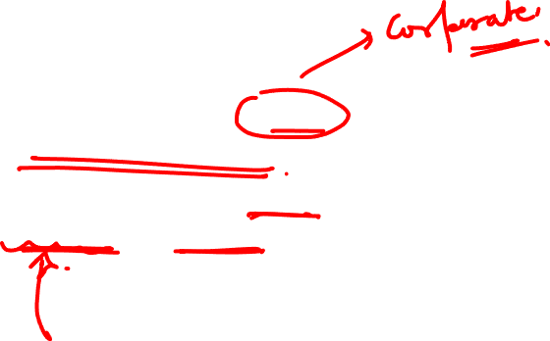
Research Methodology
Case Study Method (Data Collection)
The case study deals with the processes that take place and their interrelationship.
Case study is essentially an intensive investigation of the particular unit under consideration.

Slide 39

Research Methodology
Case Study Method

Slide 40
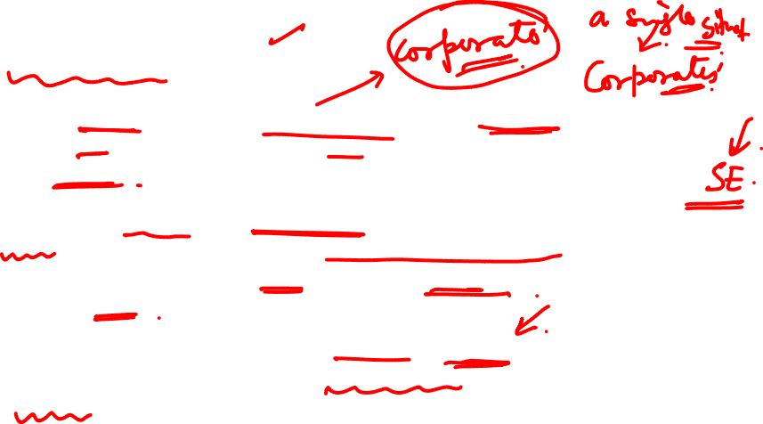
Research Methodology
Case Study Method: Characteristics
The researcher can take one single social unit or more of such units for his study purpose; he may even take a situation to study the same comprehensively.
Here the selected unit is studied intensively i.e., it is studied in minute details. Generally, the study extends over a long period of time to ascertain the natural history of the unit so as to obtain enough information for drawing correct inferences.
We make complete study of the social unit covering all facets. Through this method we try to understand the complex factors that are operative within a social unit as an integrated totality.

Slide 41

Research Methodology
Case Study Method: Characteristics
4. Under this method the approach happens to be qualitative and not quantitative. Mere quantitative information is not collected. Every possible effort is made to collect information concerning all aspects of life.
5. In respect of the case study method an effort is made to know the mutual inter-relationship of causal factors.
6. Under case study method the behaviour pattern of the concerning unit is studied directly and not by an indirect and abstract approach.
7. Case study method results in fruitful hypotheses along with the data which may be helpful in testing them, and thus it enables the generalised knowledge to get richer and richer. In its absence, generalised social science may get handicapped.

Slide 42

Research Methodology
Case Study Method: Assumptions
The assumption of uniformity in the basic human nature in spite of the fact that human behaviour may vary according to situations.
(ii) The assumption of studying the natural history of the unit concerned.
(iii) The assumption of comprehensive study of the unit concerned.

Slide 43

Research Methodology
Example of Case Study
Genie: Genie was a young girl subjected to horrific abuse and isolation. The case study of Genie allowed researchers to study whether language could be taught even after critical periods for language development had been missed. Her case also served as an example of how scientific research may interfere with treatment and lead to further abuse of vulnerable individuals.
Genie – Advantages
Uniqueness of study – Being able to study a feral child is a rare occurrence.
Genie – Disadvantages
Ethics - The lead researcher David Rigler provided a home for Genie, and was paid for being a foster parent. This is often seen as unethical, since Rigler had a financial interest in Genie and her case.
https://www.verywellmind.com/how-to-write-a-psychology-case-study-2795722

Slide 44

Research Methodology
Another Example
Gehringer, Edward F., and Barry W. Peddycord III. "The inverted-lecture model: a case study in computer architecture." In Proceeding of the 44th ACM technical symposium on Computer science education, pp. 489-494. 2013.
Abstract: This paper reports on an experience in using the inverted-lecture model ("flipping the classroom") in computer architecture. The first author concurrently taught two courses in computer architecture. One of these courses was CSC/ECE 506: Architecture of Parallel Computers, an introductory Graduate-level course, taught via lecture both residentially and distance-ed. The other was the CSC 456: Computer Architecture and Multiprocessing, a senior-level undergraduate course which was "flipped." Students in the inverted-lecture class exhibited high levels of engagement. Their performance on exams was not quite up to the level of the students in the graduate class, but the difference was not wide. From this experience, we offer observations and suggestions about inverted classes in general.
Find out more such examples in your respective branch of study!!!

Slide 45

Research Methodology
Major Phases involved in a Case Study
Recognition and determination of the status of the phenomenon to be investigated or the unit of attention.
Collection of data, examination and history of the given phenomenon.
Diagnosis and identification of causal factors as a basis for remedial or developmental treatment.
Application of remedial measures i.e., treatment and therapy(this phase is often characterised as case work).
Follow-up programme to determine effectiveness of the treatment applied.

Slide 46

Research Methodology
Advantages of case Study
Through case study a researcher can obtain a real and enlightened record of personal experiences which would reveal man’s inner strivings, tensions and motivations that drive him to action along with the forces that direct him to adopt a certain pattern of behaviour.
Information collected under the case study method helps a lot to the researcher in the task of constructing the appropriate questionnaire or schedule for the said task requires thorough knowledge of the concerning universe.
Case study method has proved beneficial in determining the nature of units to be studied along with the nature of the universe. This is the reason why at times the case study method is alternatively known as “mode of organising data”.
Case study method enhances the experience of the researcher and this in turn increases his analysing ability and skill.
There are many other merits of Case Study method

Slide 47

Research Methodology
Limitations of Case Study
Case situations are seldom comparable and as such the information gathered in case studies is often not comparable. Since the subject under case study tells history in his own words, logical concepts and units of scientific classification have to be read into it or out of it by the investigator.
Some researchers ( Read Bain etc) do not consider the case data as significant scientific data since they do not provide knowledge of the “impersonal, universal, non-ethical, non-practical, repetitive aspects of phenomena.”
Real information is often not collected because the subjectivity of the researcher does enter in the collection of information in a case study.
The danger of false generalisation is always there in view of the fact that no set rules are followed in collection of the information and only few units are studied.
It consumes more time and requires lot of expenditure.
6. Case study method is based on several assumptions which may not be very realistic at
times, and as such the usefulness of case data is always subject to doubt.

Slide 48
THANK YOU
Dr. Arti Arya
artiarya@pes.edu

